Slide 1
JavaScript
Selenium

Slide 2
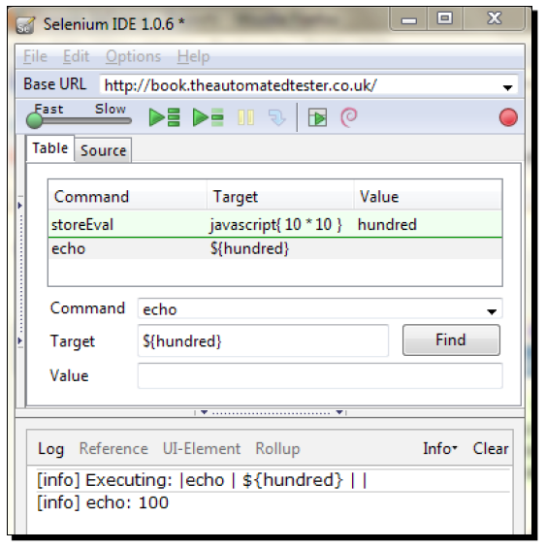
Storing Result of Javascript In Variable

Slide 3
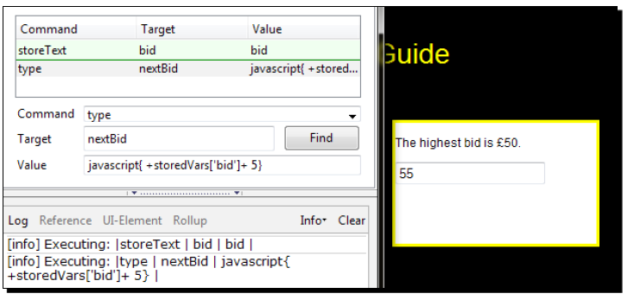
Using Selenium Variables With Javascript

Slide 4
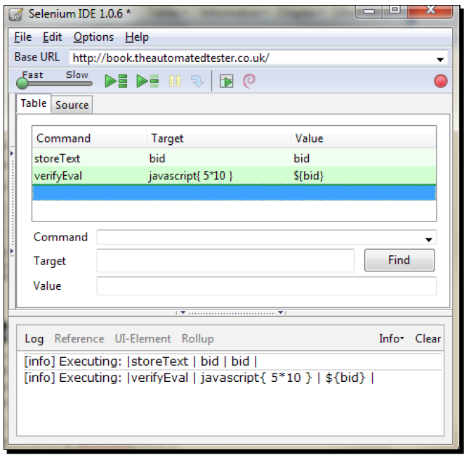
Javascript Within Verify or Assert

Slide 5
Accessing the browser with JavaScript
Selenium is built from JavaScript so that it can interact with the page in the synthesized way that a user does. When doing this, Selenium wraps the DOM in a new object.
BrowserBot is the JavaScript object that allows Selenium to control the browser. It overrides access to the window, document, and other key browser JavaScript objects that we can normally access.
var window = this.browserbot.getUserWindow();

Slide 6
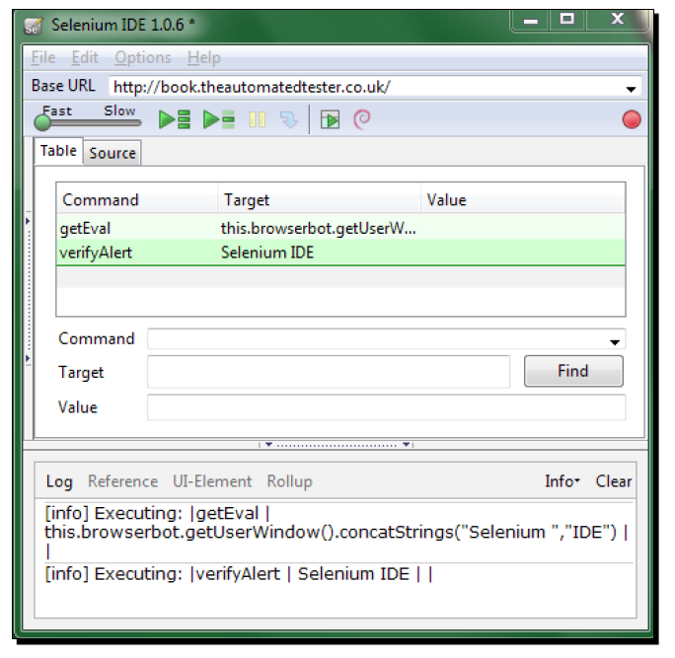
Accessing The Page With Browserbot

Slide 7
Firing Javascript Events
Sometimes there are situations where you may not be able to click on an element in the page. However, you need to make your test fire the click event.
Selenium has an API call that allows us to fire the event that is attached to elements on a page.
<div id='fireEventDiv' onClick='alert("Alert Thrown")’>
The fireEvent call specifying onClick on the above div would cause the alert to be thrown. The fireEvent works against the following JavaScript events:
onFocus
onBlur
onChange
onSubmit
onMouseOut
onMouseOver

Slide 8
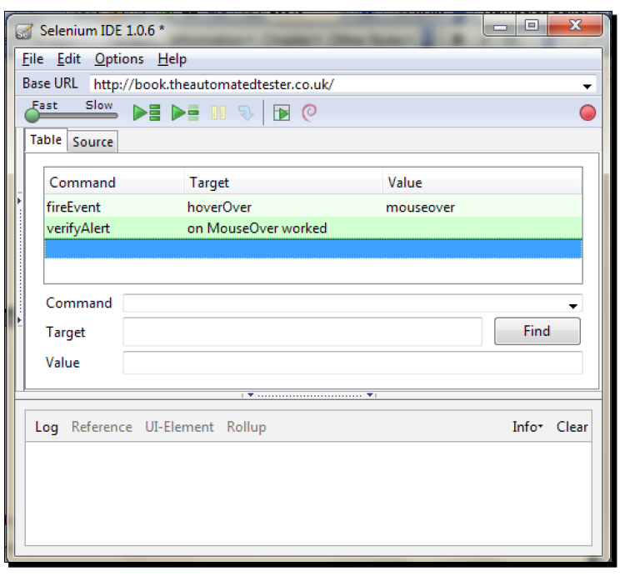

Slide 9
